Slide 1
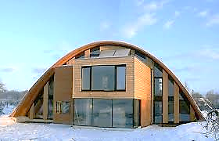
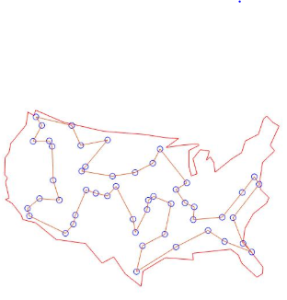
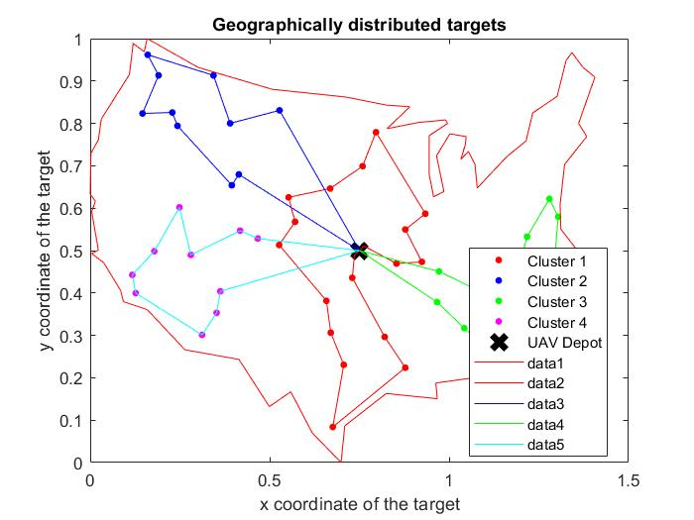
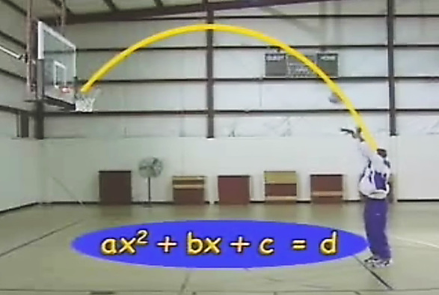
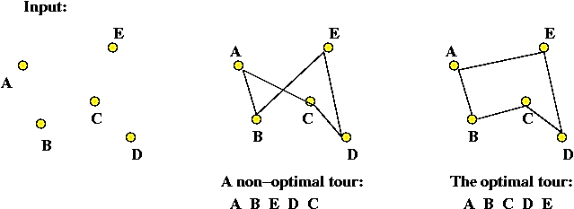
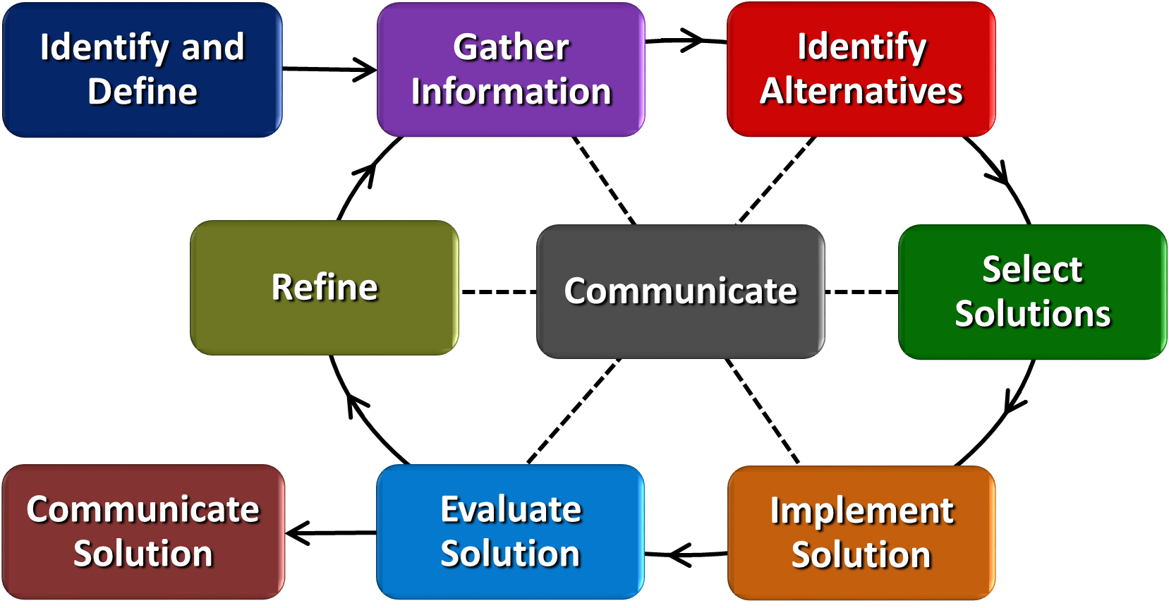
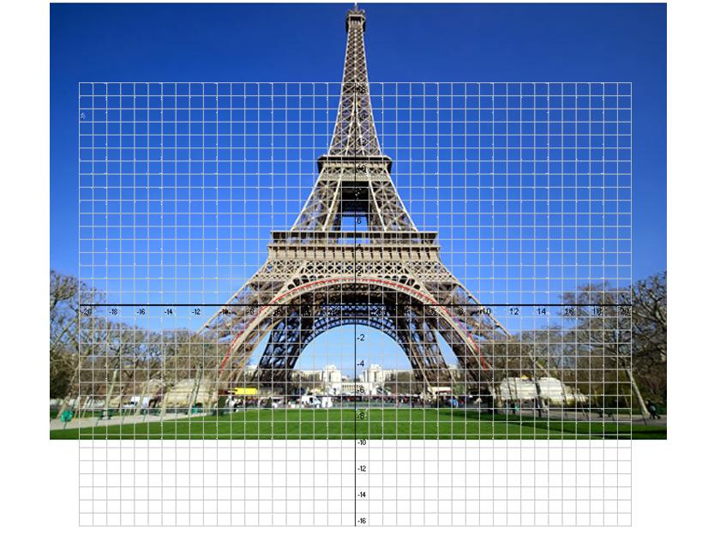
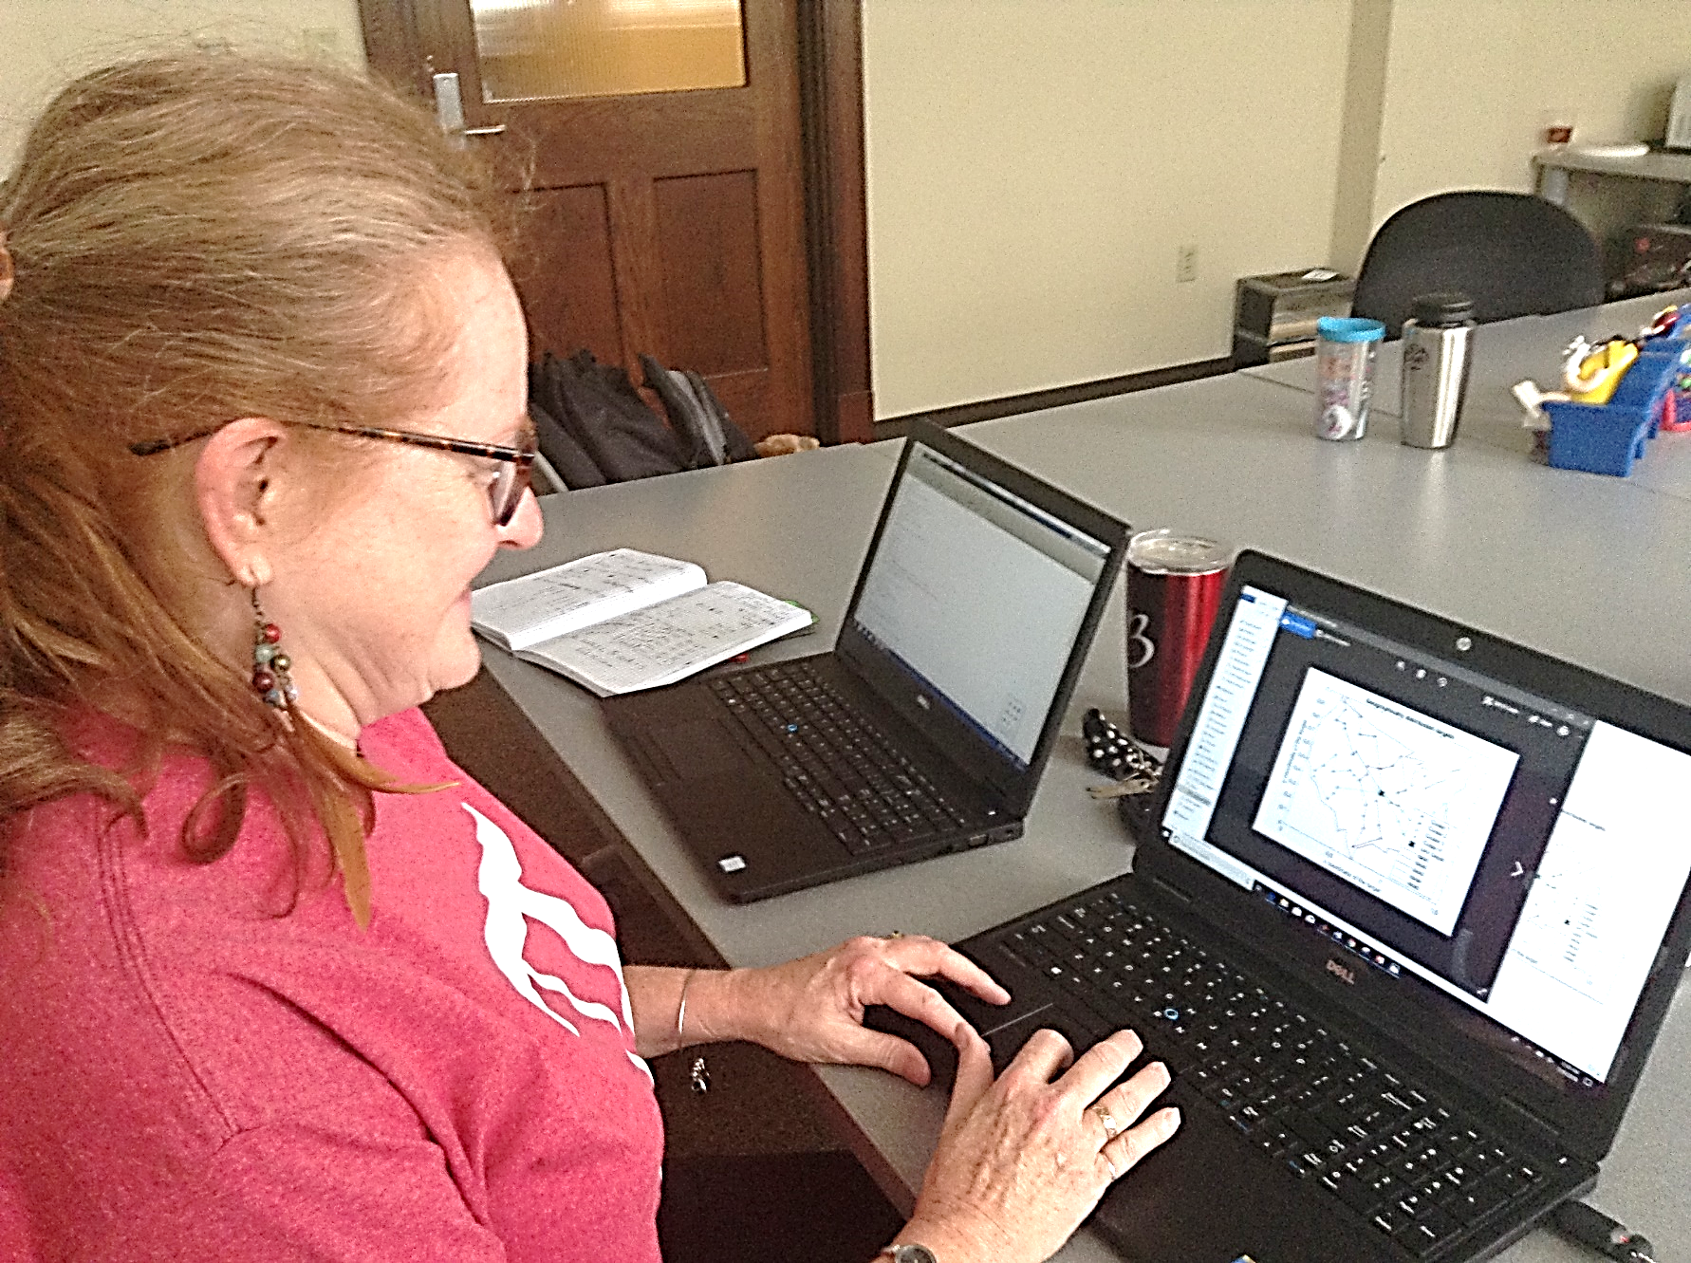
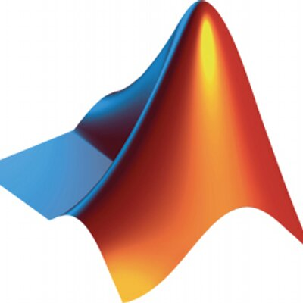
Optimization – How to Solve Real Problems Kelly Lindsey Boone County High School, Mathematics 9-12
RET is funded by the National Science Foundation, grant # EEC-1710826
Summer Research
Classroom Connections
Implementing with Students
Bio-Inspired Optimization of the
Multiple Traveling Salesman Problem
Big Ideas - Algebra as a tool for optimization and connections to the Real World.
https://i.stack.imgur.com/L1JJu.jpg
Smallest distance to travel to many cities
Delivery schedules with a depot
https://knowitall.org/video/algebra-nasa-connect-math-simulation
www.youtube.com/watch?v=peuL2qqlqVw
https://www.educationworld.com/a_curr/mathchat/images/mathchat_mosaictiles2.jp
Things to Be Able to Do
Write equations of functions
Graph functions
Research function shapes
Challenge-Based Learning
Functions as models
Building things using functions
How are the functions we know useful?
www2.seas.gwu.edu
2-Opt Algorithm
Drone lab
www.brocku.ca/blogs/futurestudents/2014/10/16/group-work-at-brock-tips-for-effective-collaboration/
Superstarfloraluk.com
Engineering Design Process
Find multiple solutions
Refine process and solutions
Communicate solutions with other people
Things to Learn
How to work independently and in a group
How to use the Algebra we already know
Connect Algebra to structures we see everyday.
MATLAB programming
MATLAB

